Slide 1
ActEU - Youth Democracy Lab
(Add location)
(Add date)
Representation, Participation and Trust in Europe
-
We need your suggestions!

Slide 2
Youth Democracy Lab
👤
Your perspective & suggestions in focus -
this is how we proceed today:
(1) Project ActEU -
Representation, Participation & Trust
(2) Group work session I -
Discussion
(3) Group work session II -
Your recommendations
👤
👤
Presenter 1
Presenter 2
Presenter 3

Slide 3
Youth Democracy Lab
🗳🧒🏾👨‍🔬
Bildnachweis: https://www.sueddeutsche.de/thema/Democracy_Lab

Slide 4
First Impressions
I have voted in a democratic election.
I have taken part in a demonstration.
I have signed a petition.
I have spoken to a politician (on site/digital).
I find the opportunities for young people to get involved in politics inviting and well communicated.
I believe that my vote makes a difference in elections.
I feel motivated and informed when it comes to political issues in Europe.

Slide 5
Insights: What does representation mean?
Representation means, above all, to standing up for someone and making groups visible in political contexts.
Those represented must be able to identify with the actions of the representatives.
👩
"And if I go back to the German EU politicians, then - well, I can only say politicians, because I think the vast majority of them are men over 45. Where you... I don't see myself represented at all."
(A participant from our focus groups - Germany)

Slide 6
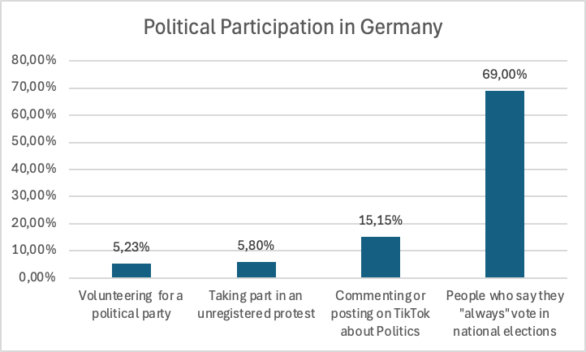
Insights: What does participation mean?
Political participation describes activity of citizens who voluntarily want to exert influence on public policy.
👨
"If you don't take part in the elections, you can't change anything."
(A participant from our focus groups - Greece)
Notes:
Hätt

Slide 7
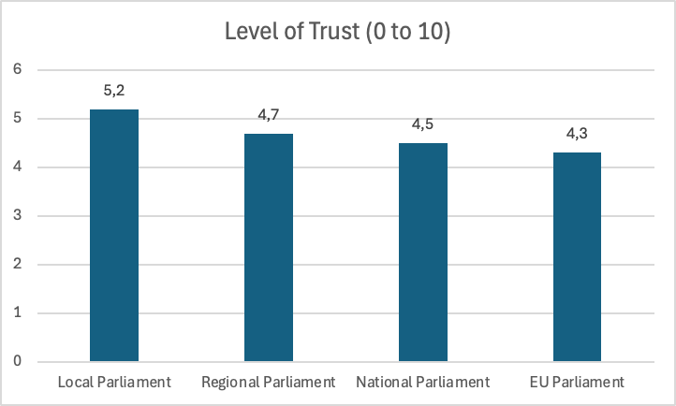
Insights: What does trust mean?
Trust means being sure that you can rely on someone or something.
👨🏾
"I didn't use to have too much faith in politics, but now I have none at all."
(A participant from our focus groups - France)

Slide 8
Youth Democracy Lab
Group 1: Representation
Group 2: Participation
Standing up for someone and making groups visible.
Those represented must be able to identify with the actions of those representing them.
Political participation describes activity of citizens who voluntarily want to exert influence on public policy.
Voting, protests (legal and illegal), party work, activism, election campaigning, petitions, (political violence)
Trust
Trust means being able to be sure that you can rely on someone or something.

Slide 9
What we want from you
We want to create toolkits for politicians and educators which build upon your recommendations!
Recommendations for policy makers
Concrete recommendations and/or examples of how politicians should act and/or what policies should be implemented to address the issues of:
Representation
Participation
Trust
Recommendations for political education
Concrete recommendations and/or examples of what tools the educational sector should use or how education should change to address the issues of:
Representation
Participation
Trust
Democracy

Slide 10
What happens next
Democracy Labs in 13 cities (10 countries)
Gathering your recommendations
Presentation of the recommendations to all ActEU partners
Development of our toolkits for politicians and for civic education

Slide 11
Youth Democracy Lab
Thank you for participating!
Bildnachweis: https://www.sueddeutsche.de/thema/ Democracy_Lab

